Slide 1
PRAIRIE VIEW A&M UNIVERSITY
HEAT RELIEF NETWORK
An AI-Assisted Community Platform for Cooling Centers & Heat Safety
CINS 5338 / 5388 — Software Project Management
Prepared by Team 5 • Checkpoint Presentation
Heat Relief Network • CINS 5338/5388 — Software Project Management
1

Slide 2
Table of Contents
1
Problem Description
9
Version Control
2
Project Vision
10
Use Case Diagram
3
Features & Benefits of the System
11
Initial Product Backlog in Jira
4
Software Stack
12
User Stories Selected for Sprint 1
5
How the Stack Works Together
13
Site Directory — Pilot Region Update
6
Development Environments / Tools
14
Sprint 1 — Team Assignments
7
Hardware Requirements
15
Description of Story 1 – 6
8
System Architecture
16
Conclusion
Heat Relief Network • CINS 5338/5388 — Software Project Management
2

Slide 3
Problem Description
Extreme heat is the deadliest weather hazard in the United States, and the people most at risk — older residents, low-income households, and anyone without reliable air conditioning — are often the same people least able to find out where a cooling center or water station is open right now.
Missed
Deadlines & Alerts
Manual, Outdated
Local governments and relief organizations run these sites, but without a shared, real-time system, residents have no reliable way to check what's open, and organizations have no clear, data-driven way to see which neighborhoods need outreach most urgently.
Site Status
No Ranked View
The Heat Relief Network closes both gaps: a resident-facing map and directory of live cooling/water sites and active heat alerts, plus an org-facing priority-matching engine that ranks areas by heat vulnerability so limited outreach resources go where they matter most.
of Highest-Need Areas
Spreadsheet-Driven
Outreach Planning
Heat Relief Network • CINS 5338/5388 — Software Project Management
3

Slide 4
Project Vision
The vision behind the Heat Relief Network is a single, always-current source of truth for heat relief in a community — one residents can check from any device to find help nearby, and one partner organizations can use to decide where to send it.
For residents, that means a simple map and list of cooling centers and water stations with live open/closed status, plus active heat alerts for their area — no more calling around or guessing which locations are actually staffed today.
For organizations, it means moving from static spreadsheets to a live, ranked view of need: a heat-vulnerability score for every tracked area, combining current heat index with demographic risk factors, and adjusted for how far the nearest open site already is.
“
One map. One ranked list. Every heat-relief resource going where it's needed most.
Product vision statement
Heat Relief Network • CINS 5338/5388 — Software Project Management
4

Slide 5
Features and Benefits of the System
1
2
3
Real-Time Site Search & Status
Priority-Area Matching Engine
Distance-Aware Resource Gap
Residents search cooling/water sites near them and see live open/closed status — no more outdated lists.
A transparent, rule-based heat-vulnerability index ranks every area by heat index + demographic risk.
Areas far from any open site score higher, surfacing under-resourced high-need areas automatically.
4
5
6
Org Admin Priority Dashboard
Map-Based Priority Overlay
Built for Real Data, Today
A ranked, filterable table with one-click recompute replaces reading raw JSON or spreadsheets.
A toggleable colored-circle layer shows residents and partners exactly where risk is concentrated.
Ships with a working, documented model now, with a clear upgrade path to live weather + Census data.
Heat Relief Network • CINS 5338/5388 — Software Project Management
5

Slide 6
Software Stack
FE
Frontend
Plain HTML / CSS / JavaScript — no build step — with Leaflet.js for the interactive map and OpenStreetMap tiles.
BE
Backend
Node.js + Express, serving REST routes: /api/sites, /api/alerts, /api/orgs, /api/risk-areas.
DB
Database
PostgreSQL 17+ with the PostGIS extension for spatial / proximity ("nearest open site") queries.
LB
Core Libraries
pg (node-postgres) for DB access, cors for cross-origin requests, dotenv for config/secrets.
AI
Scoring Engine
Custom rule-based JS heat-vulnerability scorer (riskScore.js) — transparent, no ML runtime dependency yet.
+
Planned Integrations
National Weather Service API, U.S. Census Bureau ACS API, Twilio (SMS), Firebase Cloud Messaging (push).
Heat Relief Network • CINS 5338/5388 — Software Project Management
6

Slide 7
How the Stack Works Together
cors-enabled
REST calls
pg
(node-postgres)
Client
Application
Data
Browser — HTML/CSS/JS
+ Leaflet map (OpenStreetMap tiles)
Node.js + Express REST API
sites · alerts · orgs · risk-areas
PostgreSQL 17 + PostGIS
spatial / proximity queries
Scoring Engine
riskScore.js computes a 0–100 vulnerability score from heat index + demographic inputs already in the areas table; recomputeAllRiskScores.js is the batch job that will refresh those inputs once weather/Census integration lands.
Config & Secrets
dotenv loads the database URL (and future API keys) from a local .env file kept out of version control.
Heat Relief Network • CINS 5338/5388 — Software Project Management
7

Slide 8
Development Environments / Tools
OS
Local Machine
macOS Terminal + Homebrew (brew install node, postgresql@17, postgis).
JS
Runtime
Node.js (LTS) + npm, bundled with it, for installing packages and running the server.
ED
Editor
VS Code (or equivalent) for backend, frontend, and SQL editing.
WS
Frontend Preview
Any static file server for local testing — npx serve or python3 -m http.server — a convenience, not a dependency.
AP
API Testing
curl / Postman for exercising REST endpoints during development.
Heat Relief Network • CINS 5338/5388 — Software Project Management
8

Slide 9
CONTINUED — ADDITIONAL TOOLS & HARDWARE
Development Environments / Tools
GH
Git & GitHub
Version control and collaboration — github.com/jwhawkins68/heat-relief-network, main / develop / feature-branch / PR workflow.
JR
Jira (Atlassian Cloud)
Scrum board, sprint planning, backlog and story-point tracking — project "HeatSafe" (key SCRUM).
HW
Hardware Requirements
No specialized hardware is required. Any laptop — Mac, Windows, or Linux — capable of running Node.js and a local PostgreSQL instance is sufficient for development. The priority-matching feature currently runs on a lightweight, rule-based scoring function rather than a trained model, so no GPU or elevated compute is needed at this stage.
Heat Relief Network • CINS 5338/5388 — Software Project Management
9

Slide 10
System Architecture
Client Tier
Resident map/list (index.html)
Org admin portal (admin.html)
Leaflet.js + OpenStreetMap
Planned Integrations
• National Weather Service API
• U.S. Census Bureau ACS API
• Twilio (SMS alerts)
• Firebase Cloud Messaging (push)
Application Tier
Express REST routes: sites, alerts, orgs, risk-areas
riskScore.js — heat-vulnerability scoring engine
Data Tier
PostgreSQL 17 + PostGIS
areas · sites · orgs · alerts tables + spatial index
Heat Relief Network • CINS 5338/5388 — Software Project Management
10

Slide 11
Version Control
GH
Repository
github.com/jwhawkins68/heat-relief-network
Branching Flow
main
BR
Branch Model
main (stable) ← develop ← feature/* branches, merged via Pull Request
develop
CM
Commit Hygiene
feature/ai-priority-matching
Focused commits with descriptive messages (e.g. "Add AI priority-area matching feature and Scrum backlog docs")
Authentication
Feature branches are merged back into develop via Pull Request once a story's acceptance criteria are met; develop merges into main for tested releases.
AU
HTTPS with a GitHub Personal Access Token (classic, repo scope) — GitHub retired password auth in 2021
TR
Traceability
Jira ↔ GitHub linkage keeps issues tied to the commits/PRs that implemented them
Heat Relief Network • CINS 5338/5388 — Software Project Management
11

Slide 12
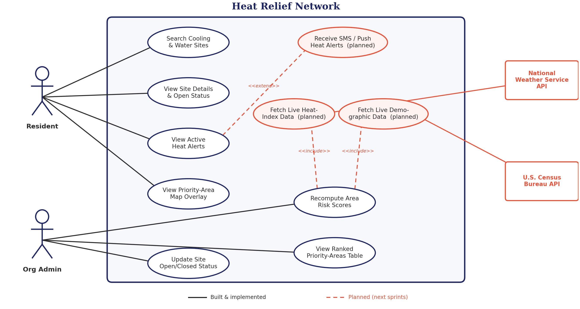
Use Case Diagram
Heat Relief Network • CINS 5338/5388 — Software Project Management
12

Slide 13
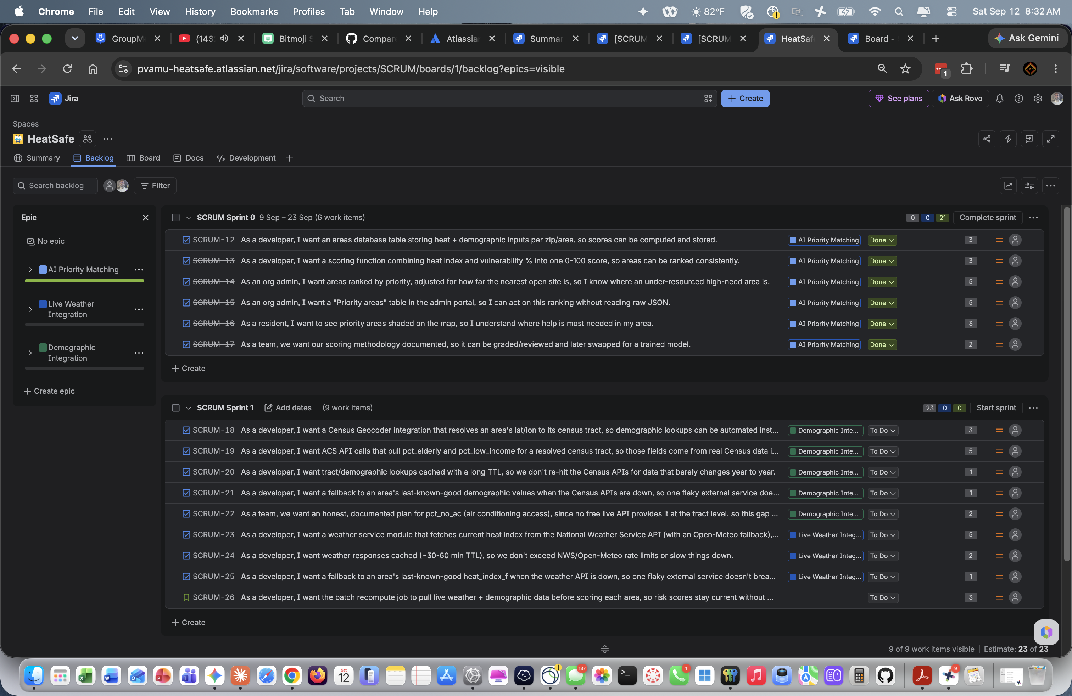
Initial Product Backlog in Jira
3 Epics
• AI Priority Matching (Done)
• Live Weather Integration
• Demographic Integration
Plus 2 items not tied to a single epic: the cross-cutting recompute story (SCRUM-26) and the Texas relief-site seed data ticket (SCRUM-27).
27 total
backlog items
story-pointed and tracked end-to-end in Jira (HeatSafe / SCRUM project)
Heat Relief Network • CINS 5338/5388 — Software Project Management
13

Slide 14
User Stories Selected for Sprint 1
Sprint 1
SCRUM-18 → SCRUM-26
9 stories across Live Weather Integration + Demographic Integration, plus the cross-cutting recompute story.
23 points
planned
SCRUM Sprint 0 (above, 6 items / 21 pts) is already Done — the AI Priority Matching epic shipped first.
Heat Relief Network • CINS 5338/5388 — Software Project Management
14

Slide 15
NEW SINCE BACKLOG WAS FIRST DRAFTED
Site Directory — Pilot Region Update
GAP
The resident site-search view had no cooling/water “site” records to show — only the priority-area overlay had real data.
FIXED — SCRUM-27 (IN REVIEW)
11 real, publicly documented relief sites seeded across the Texas pilot region.
Sites are real, verified locations — public library branches serving as official cooling centers, city recreation centers, and parks — checked against each city's library/parks department site and the Census Bureau geocoder.
Pilot region moved from an initial Los Angeles placeholder to statewide Texas, matching the project's own location (Houston) for real-world accuracy.
Site types map to the existing schema: cooling_center, water_station, shade, splash_pad. Community/rec centers are seeded as cooling_center — no separate type exists in the DB's CHECK constraint.
Status is deliberately seeded as “unknown” — real open/closed status comes from an org admin via the app's own “Update Site Open/Closed Status” flow, not from guessing it.
SITES BY CITY
Houston
4 sites
Dallas
2 sites
Fort Worth
1 site
Austin
2 sites
San Antonio
2 sites
Pending: local seed run (seed_areas.sql + seed_sites.sql) and PR merge into develop before map/admin screenshots reflect the new data.
Heat Relief Network • CINS 5338/5388 — Software Project Management
15

Slide 16
BALANCED BY STORY POINTS & SCRUM ROLE
Sprint 1 — Team Assignments
ASSIGNEE
ROLE
POINTS
STORIES
JH
James Hawkins
Engineer
SCRUM-18–22 — Demographic Integration (full epic)
12 pts
RT
Ryan Tucker
Developer
SCRUM-23 — Weather API module
5 pts
TW
Teyana Williams
Developer
SCRUM-25, SCRUM-26 — Weather fallback + cross-cutting recompute
4 pts
DL
D'Andre League (dleague)
Scrum Master
SCRUM-24 — Weather response caching
2 pts
Scrum Master (dleague) intentionally carries the lightest load — his primary Sprint 1 responsibility is facilitation, unblocking, and sprint ceremonies, not reflected in story points.
James (engineer) owns the entire Demographic Integration epic solo for continuity — one person's context across all 5 related stories avoids merge conflicts within the epic.
Ryan and Teyana split the Live Weather epic plus the cross-cutting recompute story, balanced within 1 point of each other (5 vs. 4).
SCRUM-26 depends on both epics finishing — if the larger Demographic epic runs long, the team may reassign it at standup.
Heat Relief Network • CINS 5338/5388 — Software Project Management
16

Slide 17

SCRUM-12 · AI PRIORITY MATCHING
3
Description of Story 1
pts
Heat Relief Network • CINS 5338/5388 — Software Project Management
17

Slide 18

SCRUM-13 · AI PRIORITY MATCHING
3
Description of Story 2
pts
Heat Relief Network • CINS 5338/5388 — Software Project Management
18

Slide 19

SCRUM-14 · AI PRIORITY MATCHING
5
Description of Story 3
pts
Heat Relief Network • CINS 5338/5388 — Software Project Management
19

Slide 20

SCRUM-15 · AI PRIORITY MATCHING
5
Description of Story 4
pts
Heat Relief Network • CINS 5338/5388 — Software Project Management
20

Slide 21

SCRUM-16 · AI PRIORITY MATCHING
3
Description of Story 5
pts
Heat Relief Network • CINS 5338/5388 — Software Project Management
21

Slide 22

SCRUM-17 · AI PRIORITY MATCHING
2
Description of Story 6
pts
Heat Relief Network • CINS 5338/5388 — Software Project Management
22

Slide 23
Conclusion
The Heat Relief Network already runs end-to-end: a live Express + PostGIS backend, a working resident map and org portal, and a documented, rule-based priority-matching engine that ranks neighborhoods by heat vulnerability today.
Sprint 1 is scoped and ready — Live Weather Integration and Demographic Integration will replace manually-seeded inputs with real NWS and Census data, making the priority ranking fully live without changing its transparent, explainable design.
Our Jira board and GitHub history give a verifiable record of both the process and the product — this is Agile/Scrum practiced on a real, shipping feature, not just a paper exercise.
3
Epics tracked
27
backlog items
21 / 44
points shipped
Heat Relief Network • CINS 5338/5388 — Software Project Management
23

Slide 24
THANK YOU
F O R Y O U R A T T E N T I O N
Heat Relief Network • Team 5 • CINS 5338/5388

